Slide 1
Foundation of computer science
By : Mohamed Agami

Slide 2

Lecture 17

Slide 3

Managing Files And Folders Using Command Line

Slide 4
File-naming Conventions
A-Z
a-z
0-9
_ ^ $ ~ ! # % & – { } ( ) @ ' `

Slide 5
Wildcard Characters in Command Lines
? wildcard for one character
* wildcard for one or more characters.

Slide 6
List of basic CMD commands in Windows 10

Slide 7
Assoc: View links to file types ( Assoc)
Attrib: Change the file properties to hidden or visible (attrib +-h file.txt)
Dir: Displays a list of files and folders in the current directory
Cd: Change the current directory (cd C:\Windows\System32)
Rmdir: Delete an empty folder > (rmdir Old Folder)
Del: Delete a file or files > (del file.txt)
Mkdir: Create a new folder (mkdir New Folder)
Cls: Clear the screen
Copy: Copy a file to another directory
Del: Delete a file
Echo: Display the message on the screen

Slide 8
exit - Close the command window:
Find - Search for text within a file
hostname - Display the current device name
move - Move a file to another location
type - To view the content of a text file, use the following command
start - Used to open a new program, document, or window
rename /ren - Rename a file
shutdown: /s /r /t /a
tasklist: Display a list of running processes
ping: Test network connection
ipconfig: Display network information

Slide 9

System Management & Optimization

Slide 10






Software (operation system)
Shell
Configuration data
Win32 subsystem
Win32 security subsystem
Other subsystems
Configuration files
Kernal
Executive services
Registry
Hardware abstraction layer (HAL)
Hardware

Slide 11
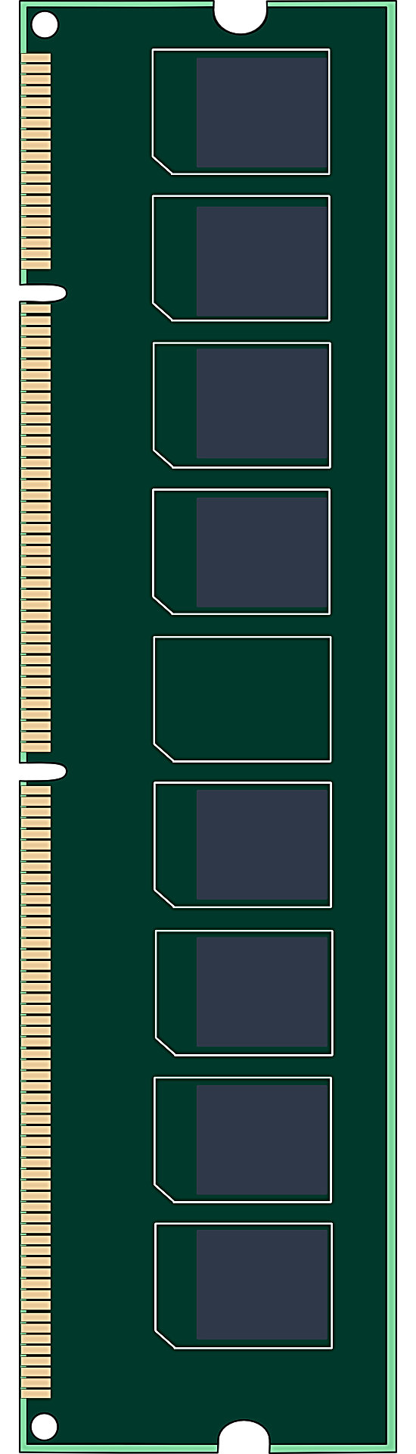
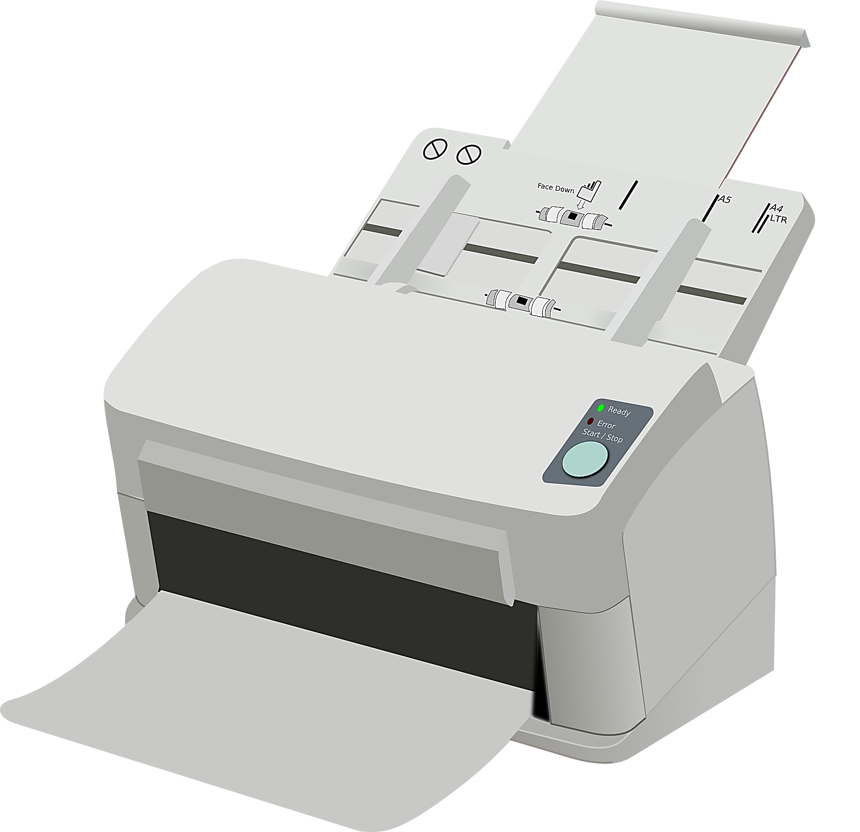

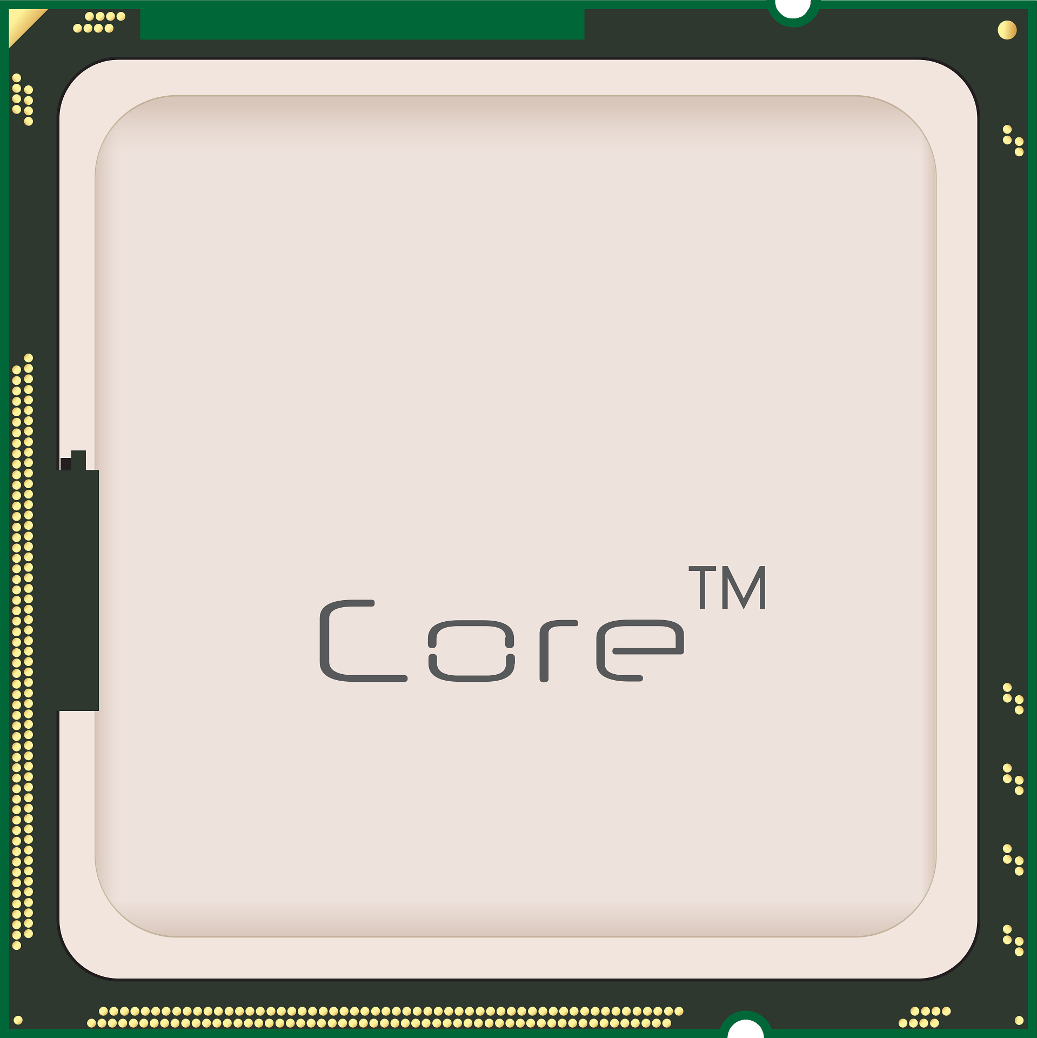

Start WinWord
Printer
Open
Shell (system 32)
Shell (system 32)
Kernal
kernel

Slide 12
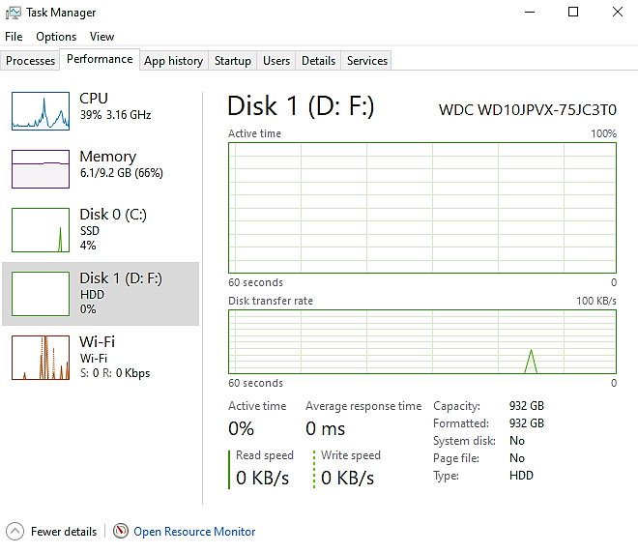
Practical application on task manger

Slide 13

Windows Registry
The Windows Registry is a central hierarchical database in Microsoft Windows operating systems, used to store system and application settings. The registry is a vital component of Windows, as it keeps important information about devices, drivers, user settings, and various configurations that make the operating system work efficiently.

Slide 14
Registry sources
Sam
Security
Software
System
Default
C:\Users\username\Ntuser.dat

Slide 15
Window registry
HKEY_CURRENT_USER
HKEY_USERS
HKEY_LOCAL_MACHINE
HKEY_CLASSES_ROOT
HKEY_CURRENT_CONFIG
Subkey
Subkey
Subkey
Value
Subkey
Value
Value
Value
Value

Slide 16
HKEY_LOCAL_MACHINE (HKLM)
contains hardware, software, and security data.
The data is taken from four hives: the SAM hive, the SECURITY hive, the SOFTWARE hive, and the SYSTEM hive.
In addition, the HARDWARE subkey of HKLM is built when the registry is first loaded, based on data collected about the current hardware configuration.
HKEY_CURRENT_CONFIG (HKCC)
contains information that identifies each hardware device installed on the computer.
HKEY_CLASSES_ROOT (HKCR)
Stores information that determines which application is opened when the user double-clicks a file.
Data for this key is gathered from the HKLM key and the HKCU key.
HKEY_USERS (HKU)
contains data about all users and is taken from the DEFAULT hive.
HKEY_CURRENT_USER (HKCU)
The key is built when a user signs in using data kept in the HKEY_USERS key and data kept in the Ntuser.dat file of the current user.

Slide 17
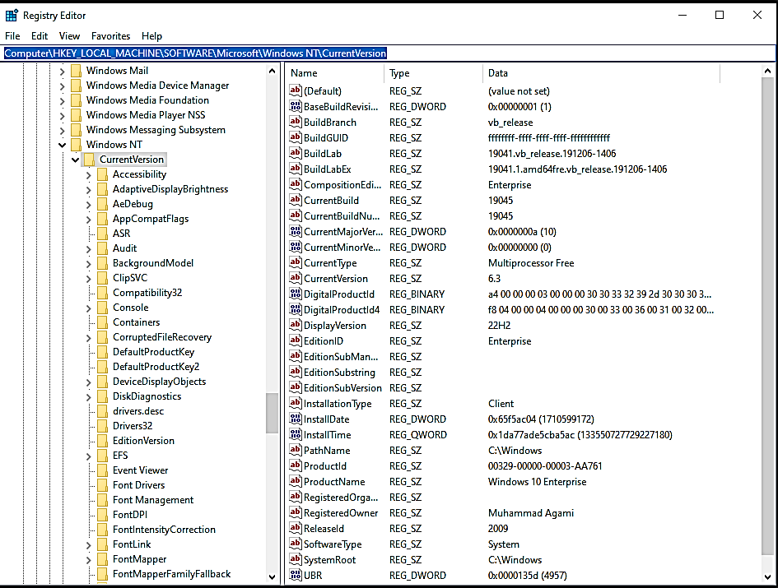

Slide 18
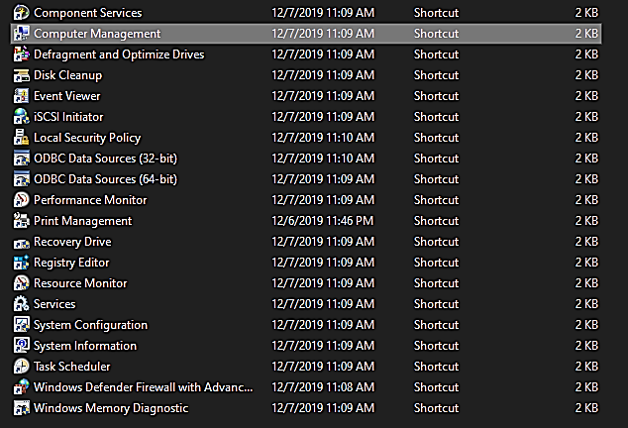

Slide 19

Windows update

Slide 20
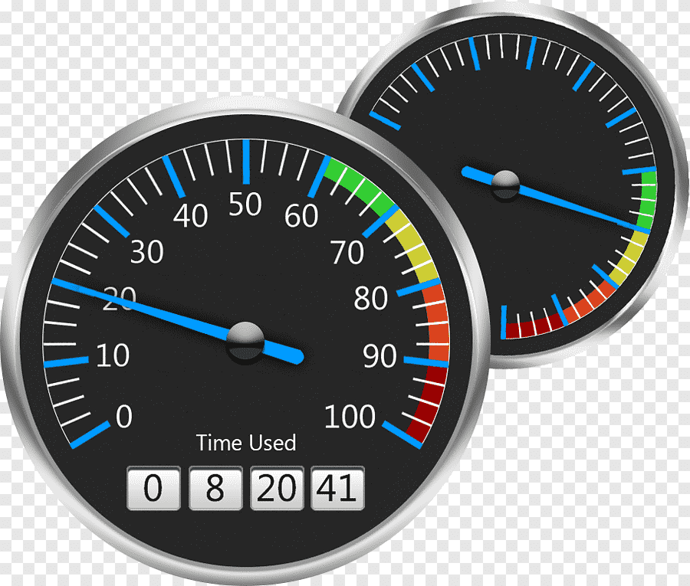
Improving Windows Performance

Slide 21
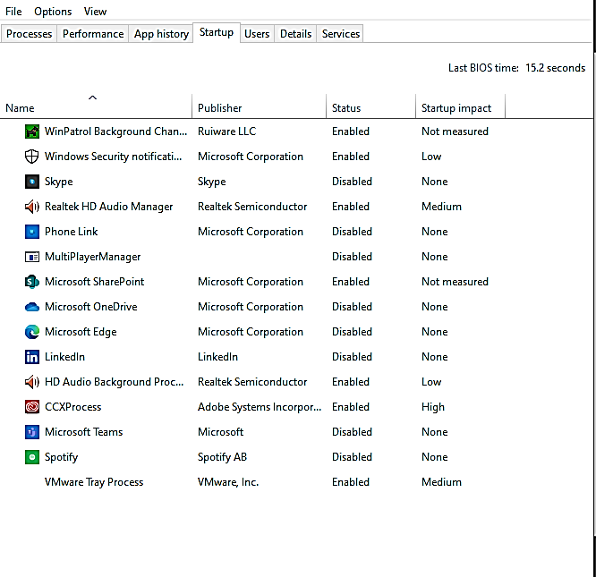
1.Disable Startup Programs
Use Task Manager (Ctrl + Shift + Esc) > Startup tab to disable unnecessary programs that start with Windows.

Slide 22

2.Clean Up Disk Space:
Run "Disk Cleanup" or use third-party tools like CCleaner to remove temporary files, caches, and unused system files.

Slide 23
Upgrade Hardware:
Upgrade to an SSD for faster boot times and app loading and increase RAM for better multitasking performance.

Slide 24
Random access memory
Operation system
Application 1
Application 2
Application 3
Application 4
HDD
Swapping
Pagefile.sys

Slide 25
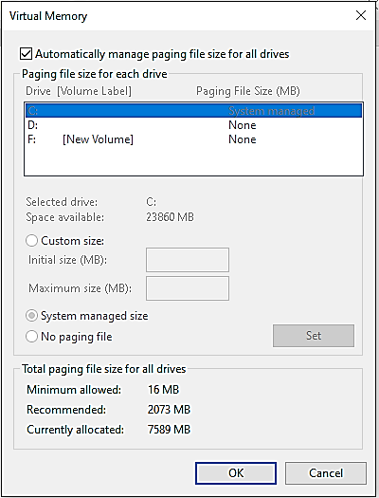
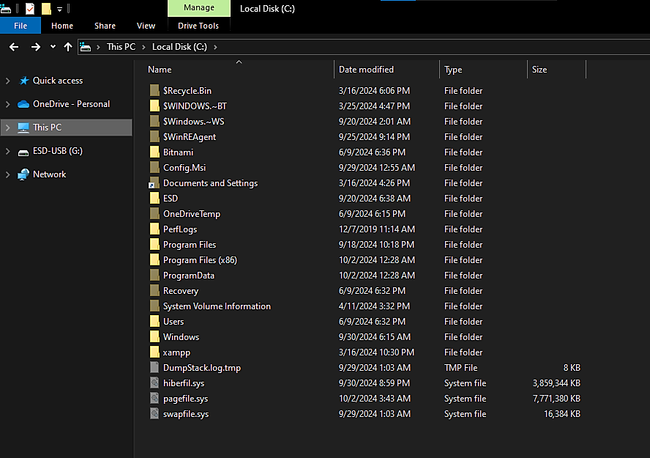

Slide 26
Uninstall Unnecessary Programs:
Go to Settings > Apps > Apps & Features and uninstall programs you don’t need

Slide 27
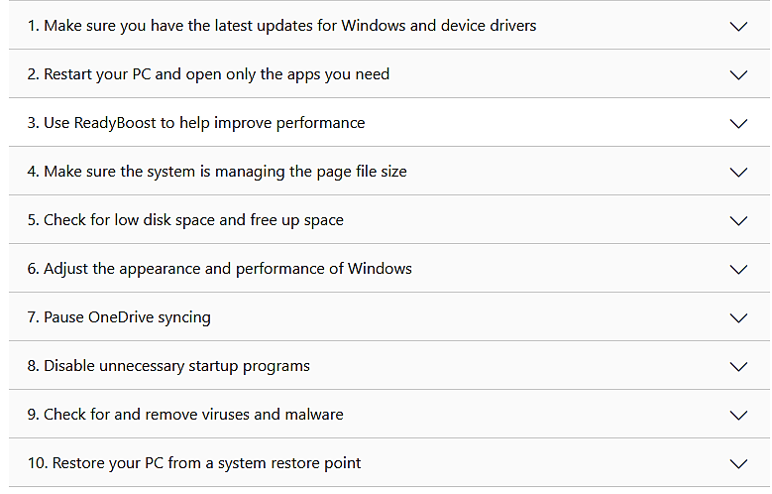
Anther form here

Slide 28

System Protection

Slide 29

Backup
Backup is the process of creating a copy of original data and storing it in a separate location or storage medium (such as hard drives, cloud storage, or external devices) to protect it from loss or damage. Backup allows the recovery of data in case of an error, such as device failure, data loss, or malware attack.

Slide 30
Planning for Disaster Recovery

Slide 31
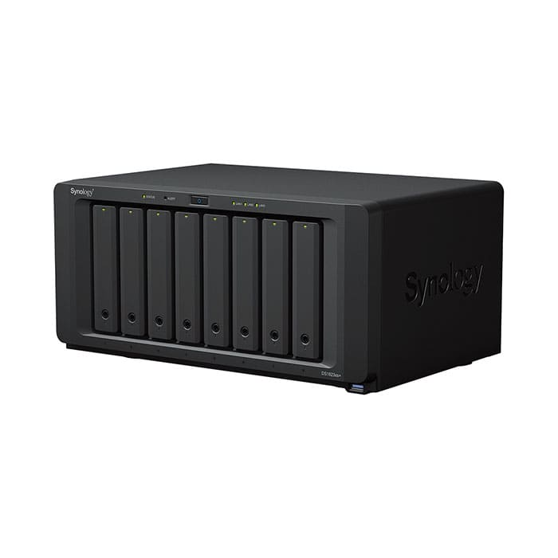



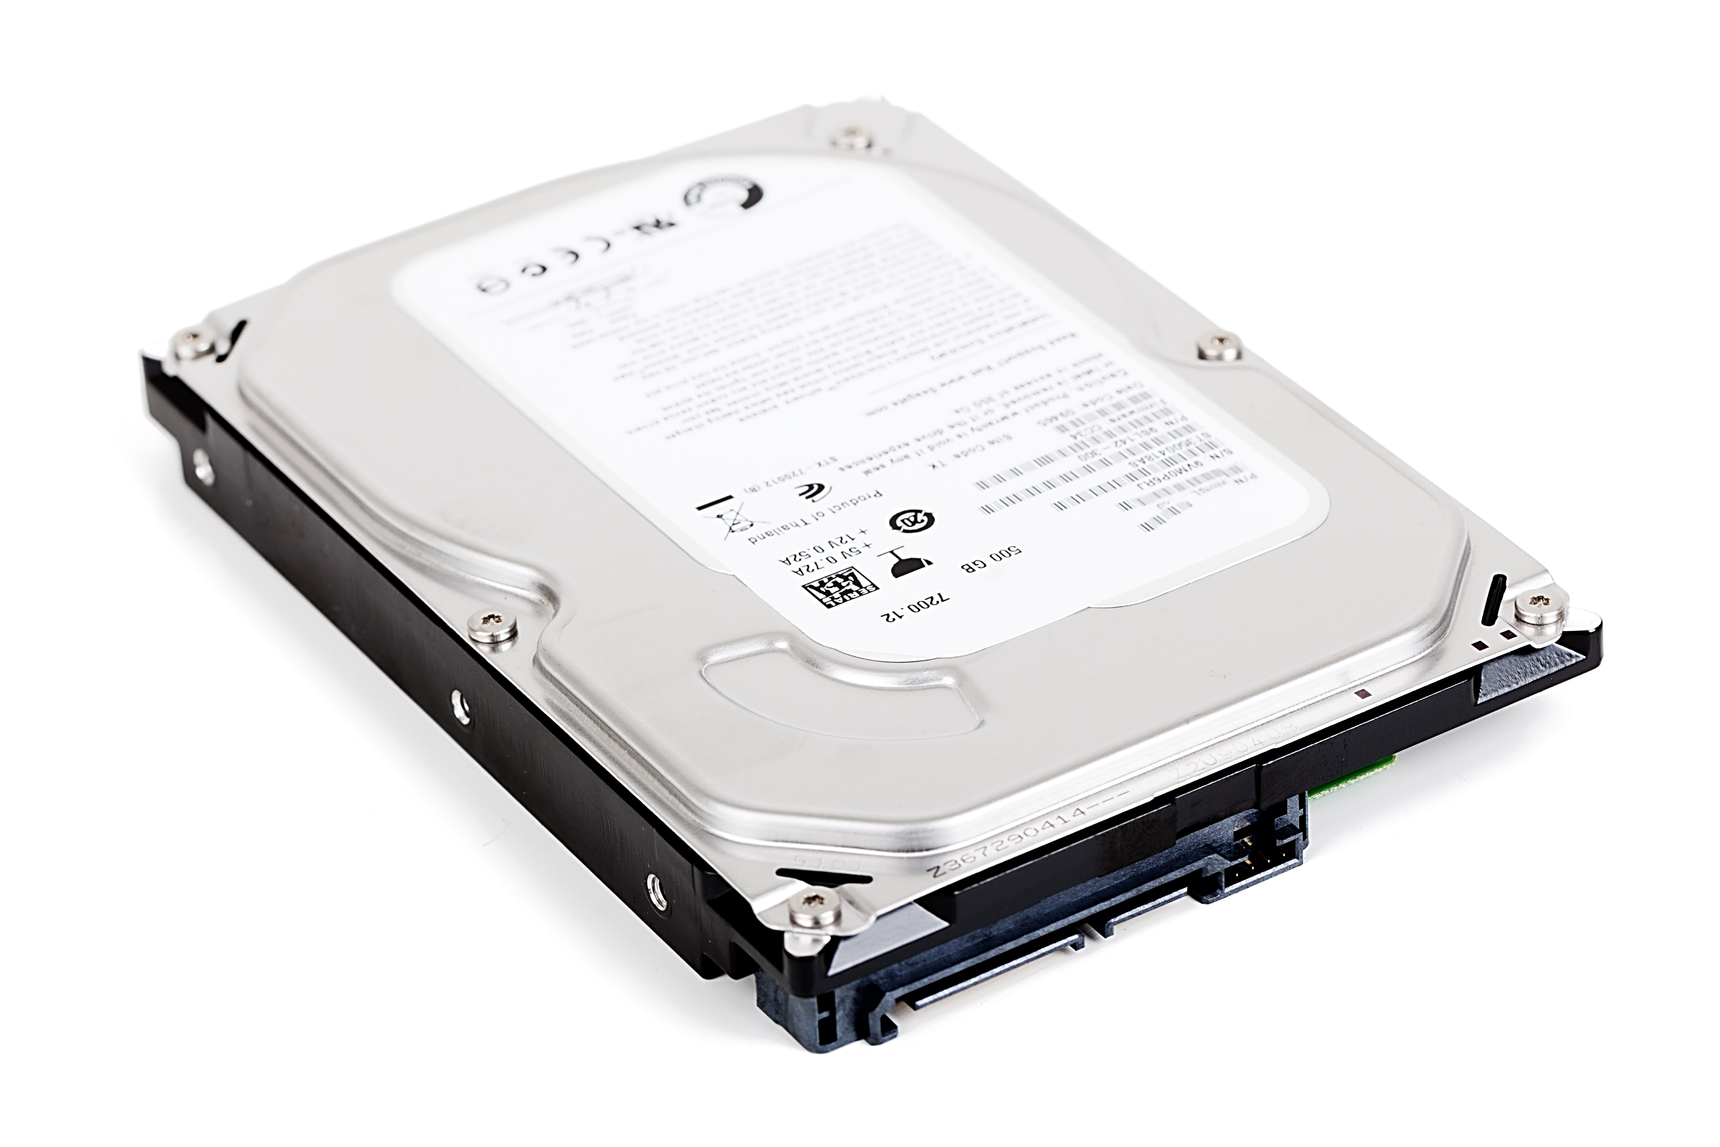
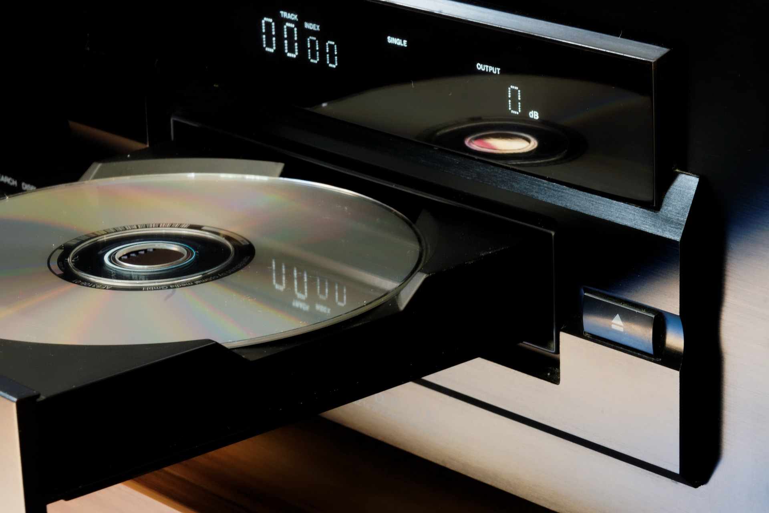
Decide on the backup destination.
Network Attached Storage

Slide 32

Decide on the backup software.
Decide how simple or complex your backup strategy needs to be.
Test the recovery process.
Keep backups in a safe place and routinely test them.

Slide 33
Backup Tools
System Image Backup
File History
System Restore
Previous Version(Shadow Copy)

Slide 34

Tank you

